Slide 1
AI-Driven Automated Selection of Job-Fit Candidates using PJFNN and OCR
EAI6980 Integrated Exp. Capstone
Team
Harshita Atray
Jianming Ma

Slide 2
Problem Statement
In today's globalized and digitized recruiting environment, companies face the challenge of selecting the most suitable candidate for a particular position from among a large number of applicants.
In addition, manual screening of resumes may not guarantee consistency and accuracy of decision when they faced with a large number of applications.
Although hiring managers can use their expertise and experience to make decisions, the process is often time-consuming and can be subject to subjective bias.

Slide 3
Our Purpose:
1. Move a step further than recommendation systems and quantify the match between the candidate and the job.
2. Create a resume screening and candidate selection system that reduces subjective bias.
3. Establish an end-to-end automated recruitment system to help HRs find the most suitable applicant for the job.
The objective of this project is to enhance the existing candidate recommendation systems by utilizing deep learning to accurately quantify the match score between a person (resume) and a job profile.
Keywords: resume screening, optical character recognition, similarity scoring, natural language processing, text - CNN, Person-Job Fit Neural Network.

Slide 4

Problem Solution (Our Goal 1) — Prediction of job matching suitability
AI models can further predict their likely performance in the role. This can be done by analyzing information such as their past work experience, educational background, age, or work performance.

Slide 5
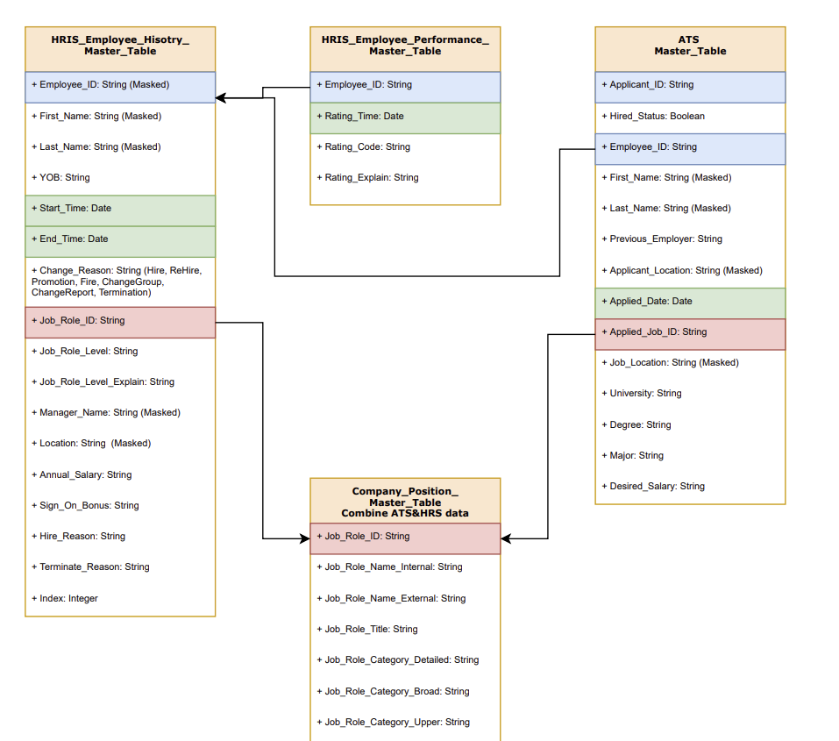
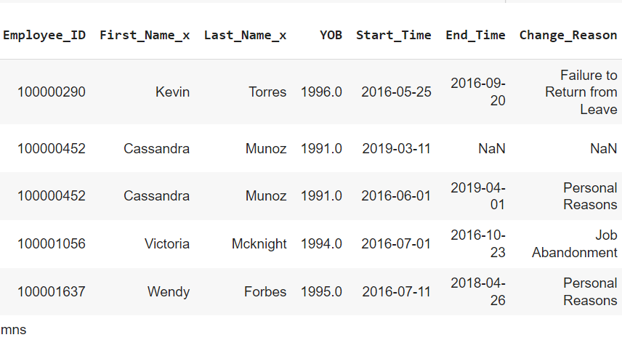
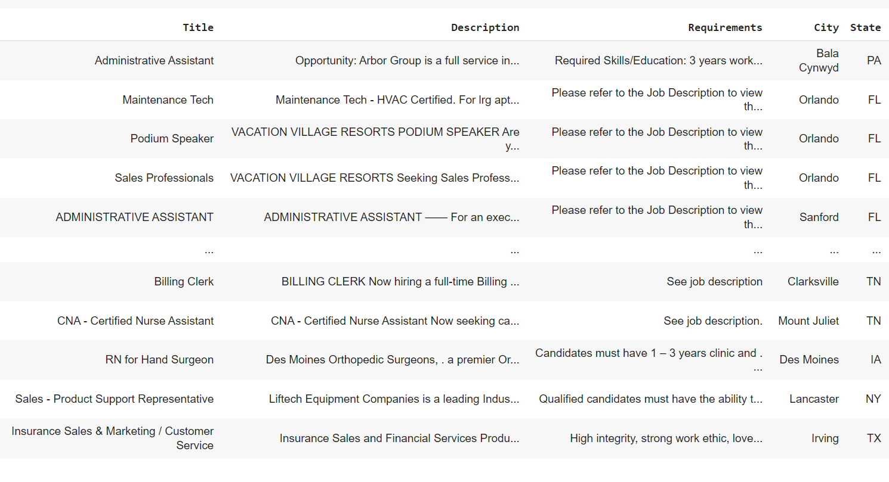
Introduction data:
Sponsor's Data：
Kaggle's Data：
Kaggle's Data is text data used to analyze job descriptions through Text-CNN model
Sponsor data is mainly used by us to calculate candidates’ features.
Source: https://www.kaggle.com/competitions/job-recommendation/data

Slide 6
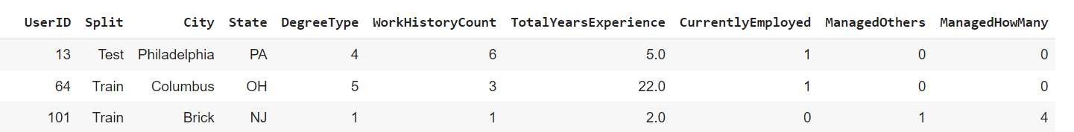
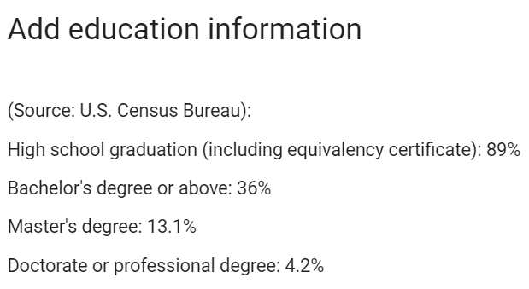
Data Preprocessing
From the US government data, we randomly filled in the data of degrees. 4.2% Phd degree, (13.1%-4.2% = ) 8.9% Master’s degree.

Slide 7
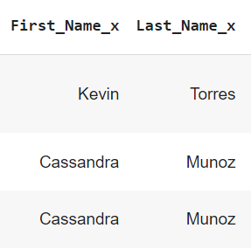
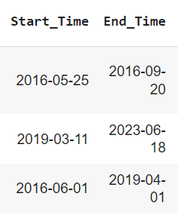
Data Preprocessing
Group the columns First_Name_x and Last_Name_x and count the number of identical names in each group.
When the work end date is today, we define the candidates as employing (1), if not, they are defined as not employing (0).
Calculate the work experience of each candidate by their work start date and work end date.

Slide 8
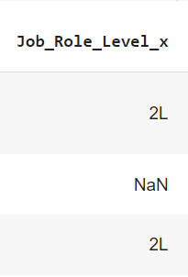
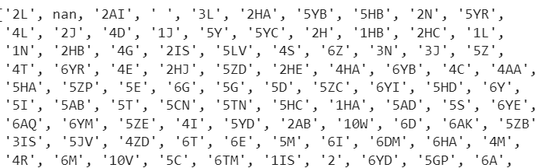
Data Preprocessing (Soft Skill)
When Job_Role_Level_x is greater than or equal to 3, we define managed Others is 1, and others are 0.
ManagedHowMany is 10 when Job_Role_Level_x is equal to 3
ManagedHowMany is 50 when Job_Role_Level_x is equal to 4
ManagedHowMany is 100 when Job_Role_Level_x is equal to 5
ManagedHowMany is 500 when Job_Role_Level_x is equal to 6

Slide 9

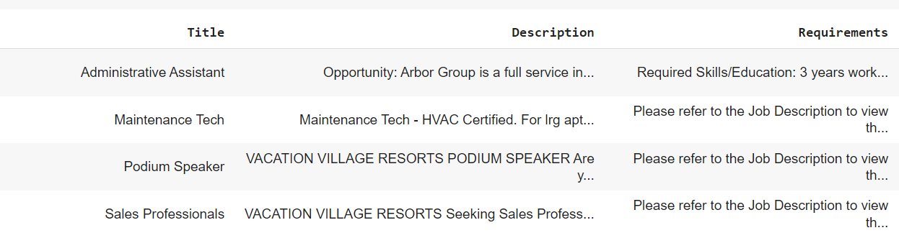
Data Preprocessing
According to the Org column in the sponsor's data, we did a text match with the job title in kaggle's data and generated the same user id for them. The purpose of this is for job description on kaggle’s data.
Kaggle's Data：

Slide 10
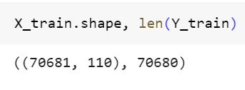
Extract the Key Word （Term frequency–inverse document frequency）
1-gram (Unigram): refers to a single word, for example, the 1-gram features of the sentence "how are you?" include "how", "are", and "you".
2-gram (Bigram): A feature consisting of two consecutive words. The 2-gram features for the sentence "how are you?" include ""how are" and "are you".
max_features=100 indicates that only the 100 features with the highest frequency (from 1-gram and 2-gram) are selected.
Weights text features by calculating the importance of words in the text.

Slide 11
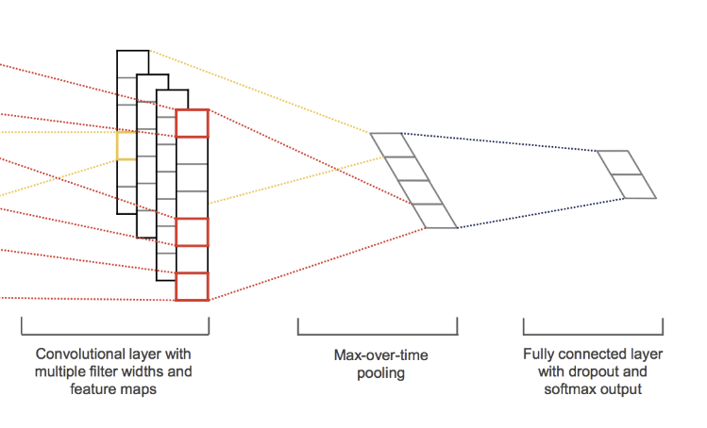
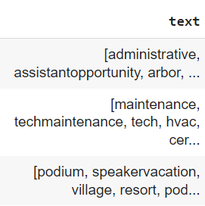
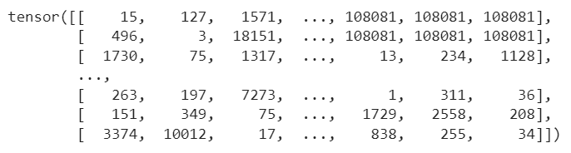
Person-Job Fit Neural Network
Job – Layer: Text - CNN
Extract local features in job text based on convolutional neural network (TextCNN).
word2vec.model:
TextCNN is a type of convolutional neural network used for text classification and text processing tasks. For us, It is applied to text feature extraction (and classification tasks in the field of natural language processing.)
word2vec.model:
Get the vector representation of text words, by calculate the similarity between words.

Slide 12
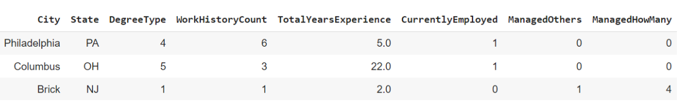
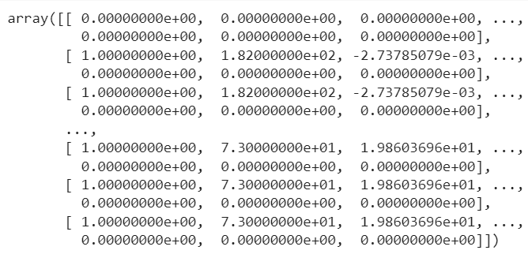
Person-Job Fit Neural Network
User (Candidate) – Layer: Multilayer Perceptron
This MLP consists of two fully linear connected layers and two activation functions (ReLU, Sigmoid). For our project, this MLP is used to process user-related features.
Finally, we have another MLP that concatenates the feature vectors of job and user, which performs dimension transformation through a linear transformation layer. The final output is a scalar value indicating how well the features of user and job description match.

Slide 13
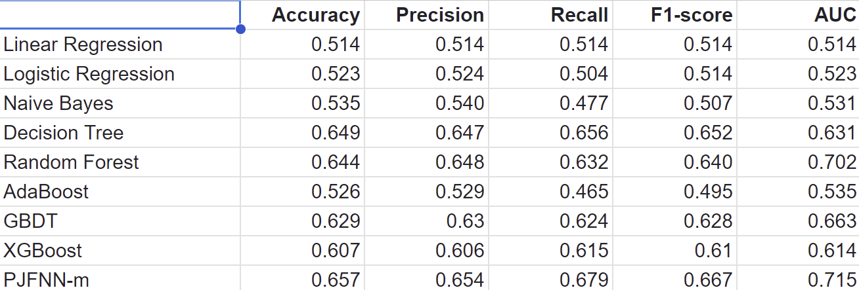
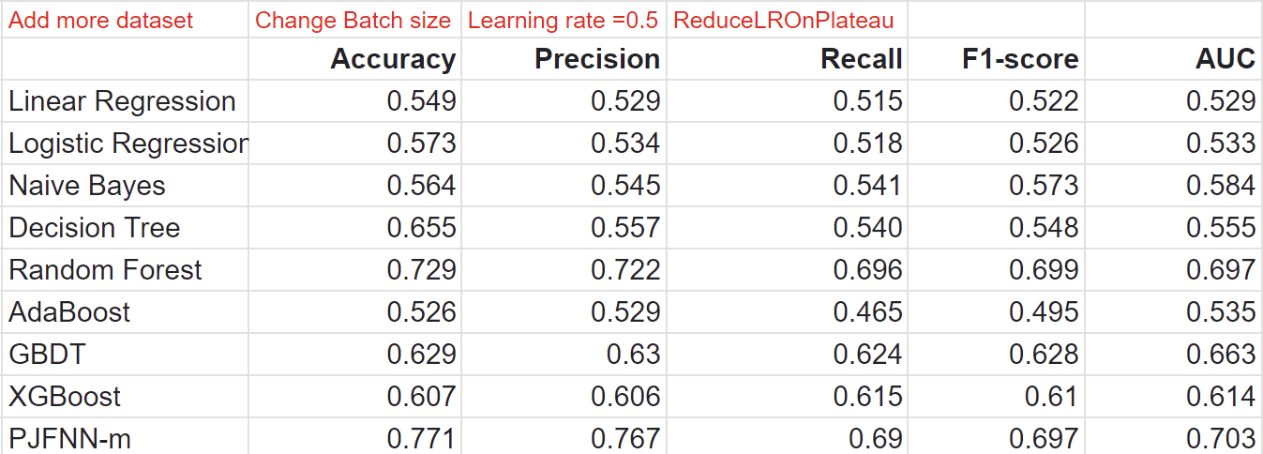
Compare with other models:

Slide 14
Problem Solution (Our Goal 2) — Automatic Resume Screening
AI models can understand key information in resumes, such as educational background, work experience, skills, etc., through Natural Language Processing technology. The model can then automatically match suitable resumes based on the given job requirements.
However, most resumes uploaded on job boards are in pdf format which is difficult to parse.
Pdf file is converted into binary image and text is recognized from these images through Optical Character Recognition using Pytesseract.
After parsing through the resume the text can be checked and corrected manually if needed.

Slide 15
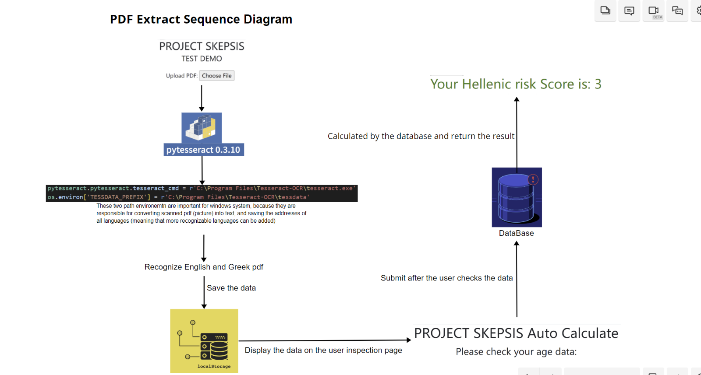

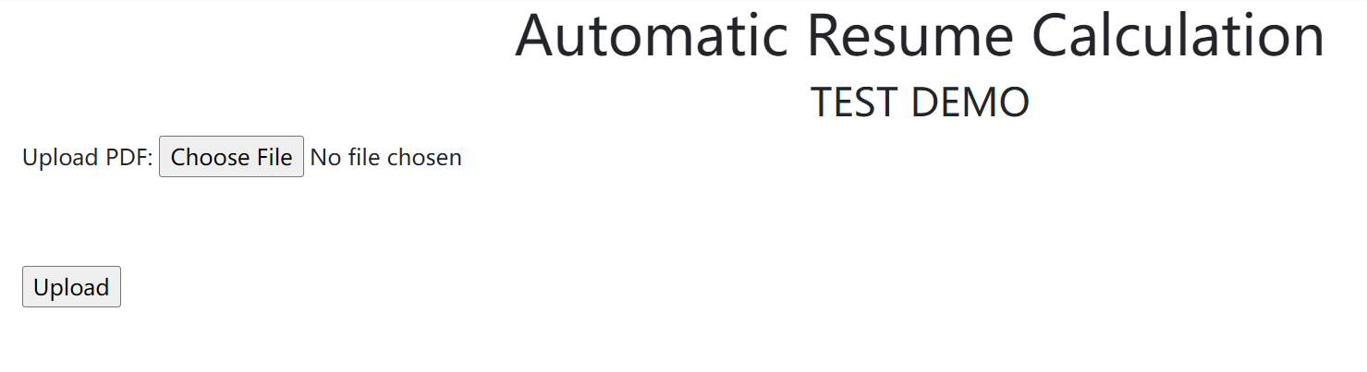

Slide 16
Conclusion and Key Takeaways
PJFNN offers the best performance metrics followed by Random Forest.
Changing the model hyperparameters improved the accuracy and other performance metrics. The accuracy increased to 0.771. Hyperparameter optimization is a necessary part of modeling for the best model performance.
A balance of automation and human decision
Since AI removes subjective bias and humans can monitor bias in data and model, there needs to be a balance between the two to make the best decision.

Slide 17
Future work
The accuracy of the model could be improved by gaining more and more information about the applicant to introduce more features.
The model relies on the accuracy of the applicant’s resume and the information provided by the applicants about their skills. For more reliable results the employee’s technical skills as well as soft skills must be tested and compared to the job profile to ensure fairness. However, more research is needed to determine a fair skill assessment method.
Named Entity Recognition (NER) using libraries like SpaCy along with Optical Character Recognition (OCR) for even more accurate identification of relevant keywords, name, location, companies, etc. in the resume.

Slide 18
References
Jiang, J., Ye, S., Wang, W., Xu, J., & Luo, X. (2020, October 19). Learning Effective Representations for Person-Job Fit by Feature Fusion. Proceedings of the 29th ACM International Conference on Information & Knowledge Management. https://doi.org/10.1145/3340531.3412717
Zhang, Y., Ai, Q., Chen, X., & Croft, W. B. (2017, November 6). Joint Representation Learning for Top-N Recommendation with Heterogeneous Information Sources. Proceedings of the 2017 ACM on Conference on Information and Knowledge Management. https://doi.org/10.1145/3132847.3132892
Wang, Z., Wei, W., Xu, C., Xu, J., & Mao, X. L. (2022, August). Person-job fit estimation from candidate profile and related recruitment history with co-attention neural networks. Neurocomputing, 501, 14–24. https://doi.org/10.1016/j.neucom.2022.06.012
Robbins, S. P. (2001). Organizational behavior (9th ed.). Upper Saddle River, NJ: Prentice Hall.
Carless, S. A. (2005, September). Person-job fit versus person-organization fit as predictors of organizational attraction and job acceptance intentions: A longitudinal study. Journal of Occupational and Organizational Psychology, 78(3), 411–429. https://doi.org/10.1348/096317905x25995
Poropat, A. E. (2009, March). A meta-analysis of the five-factor model of personality and academic performance. Psychological Bulletin, 135(2), 322–338. https://doi.org/10.1037/a0014996
Cao, S., Lu, W., & Xu, Q. (2016, February 21). Deep Neural Networks for Learning Graph Representations | Proceedings of the AAAI Conference on Artificial Intelligence. Deep Neural Networks for Learning Graph Representations | Proceedings of the AAAI Conference on Artificial Intelligence. https://doi.org/10.1609/aaai.v30i1.10179
Zhu, C., Zhu, H., Xiong, H., Ma, C., Xie, F., Ding, P., & Li, P. (2018). Person-job fit: Adapting the Right Talent for the Right Job with Joint Representation Learning. ACM Transactions on Management Information Systems, 9(3), 1–17. https://doi.org/10.1145/3234465
Chandio, A. A., Asikuzzaman, M., Pickering, M. R., & Leghari, M. (2022). Cursive Text Recognition in Natural Scene Images Using Deep Convolutional Recurrent Neural Network. IEEE Access, 10, 10062–10078. https://doi.org/10.1109/access.2022.3144844
Rice, S. V., Nagy, G., & Nartker, T. A. (1999). Optical Character Recognition. https://doi.org/10.1007/978-1-4615-5021-1

